Slide 1
The Avengers of Innovation
Empowering Girls in IoT and 5G Universe
SMAP Labu, Negeri Sembilan
3 August 2024 (Saturday)

Slide 2
IoT and 5G
(Get your hands dirty)

Slide 3
IoT and 5G
(using Tinkercad & ESP8266)

Slide 4


Slide 5


Slide 6
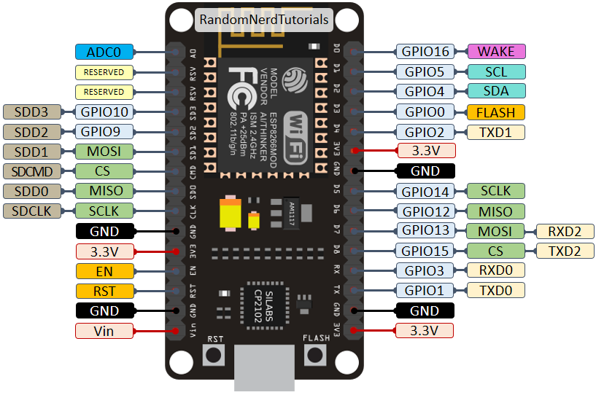
ESP 8266

Slide 7
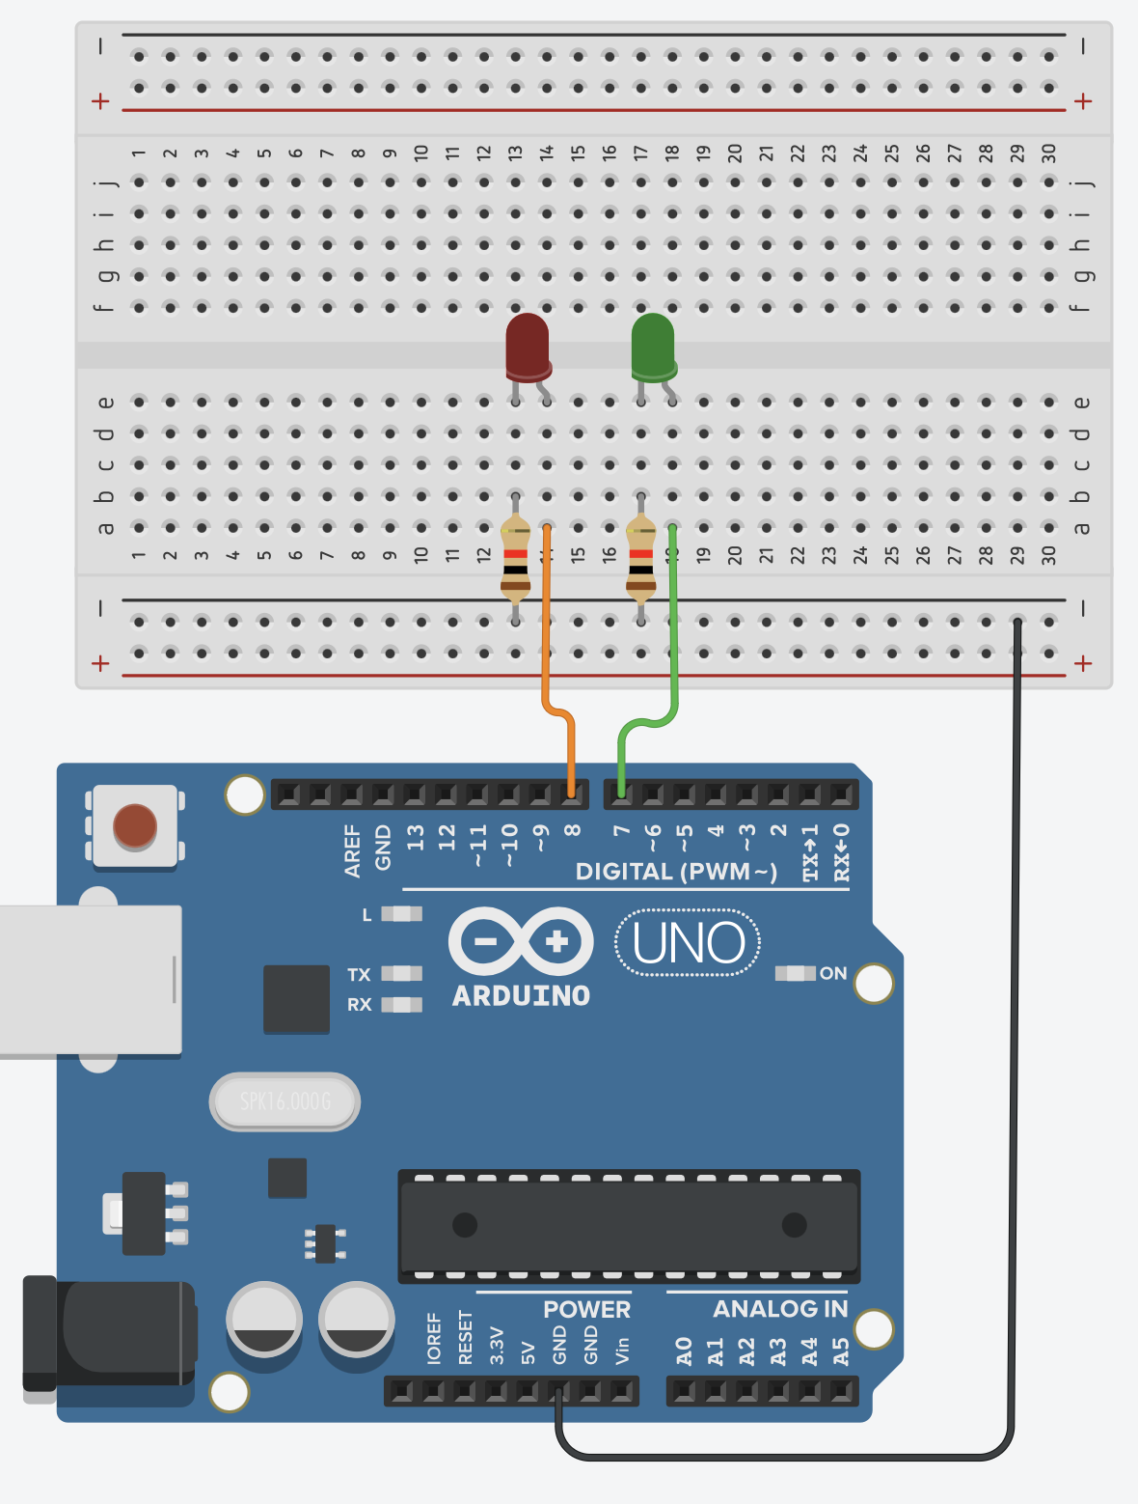
Task 1: LEDs Blinking
Mission: To turn two LEDs (pin D7 and D8) alternately ON and OFF with a period of 1 second
Description:
Two LEDs will be blinking alternately in sequence.
Steps:
Connect two LEDs to pin D7 and pin D8.
Write down the algorithm to perform this operation.

Slide 8
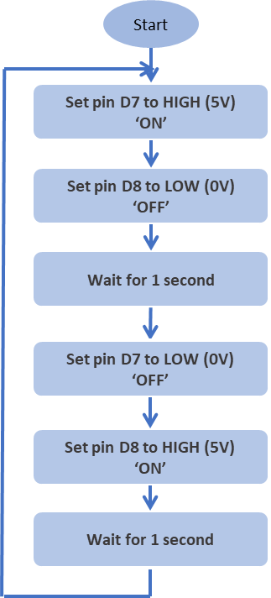
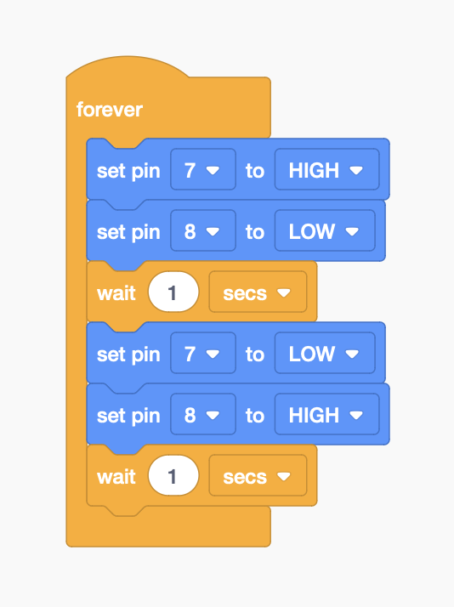
Task 1: LEDs Blinking

Slide 9
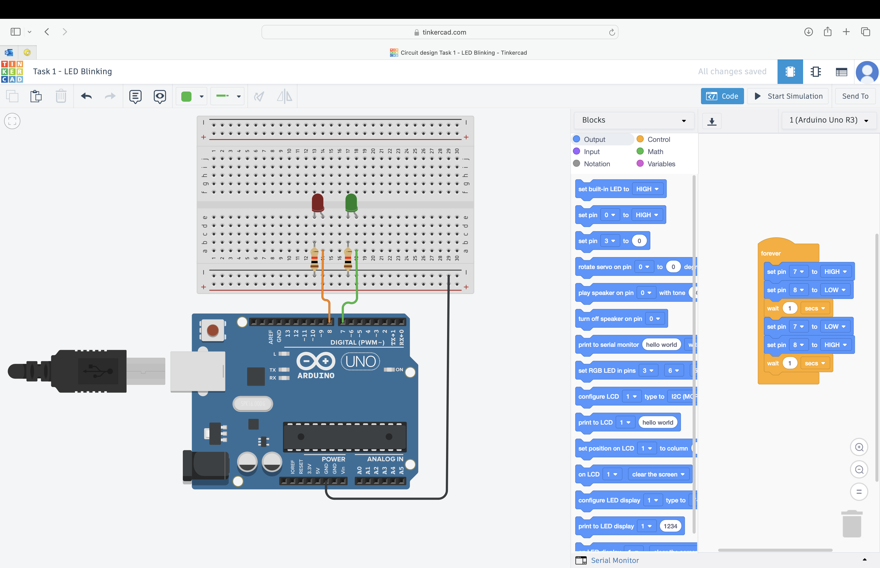

Slide 10


Slide 11
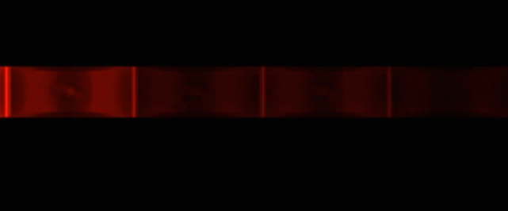
Task 2: Knight Rider LEDs
Mission: You are given four (4) LEDs. Turn ON and OFF each LED with 0.2s delay with knight rider pattern as shown below.

Slide 12
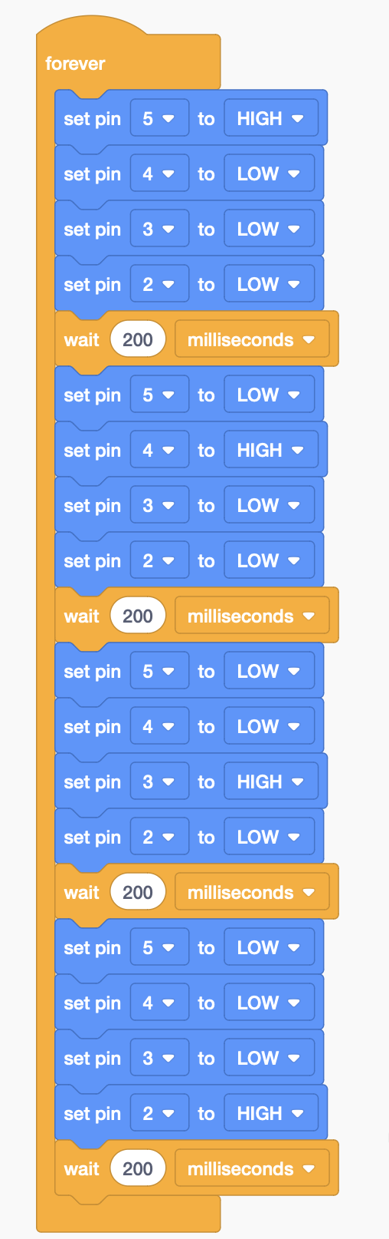
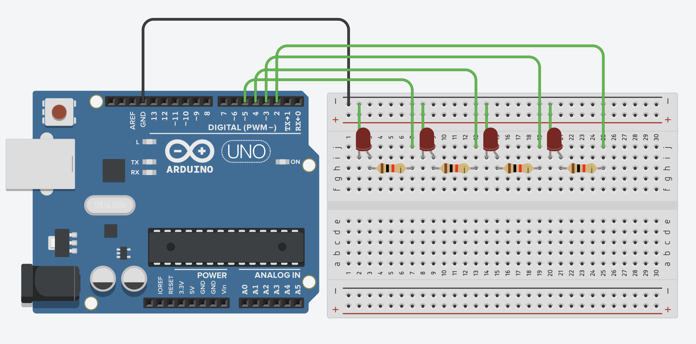
Task 2: Knight Rider LEDs

Slide 13
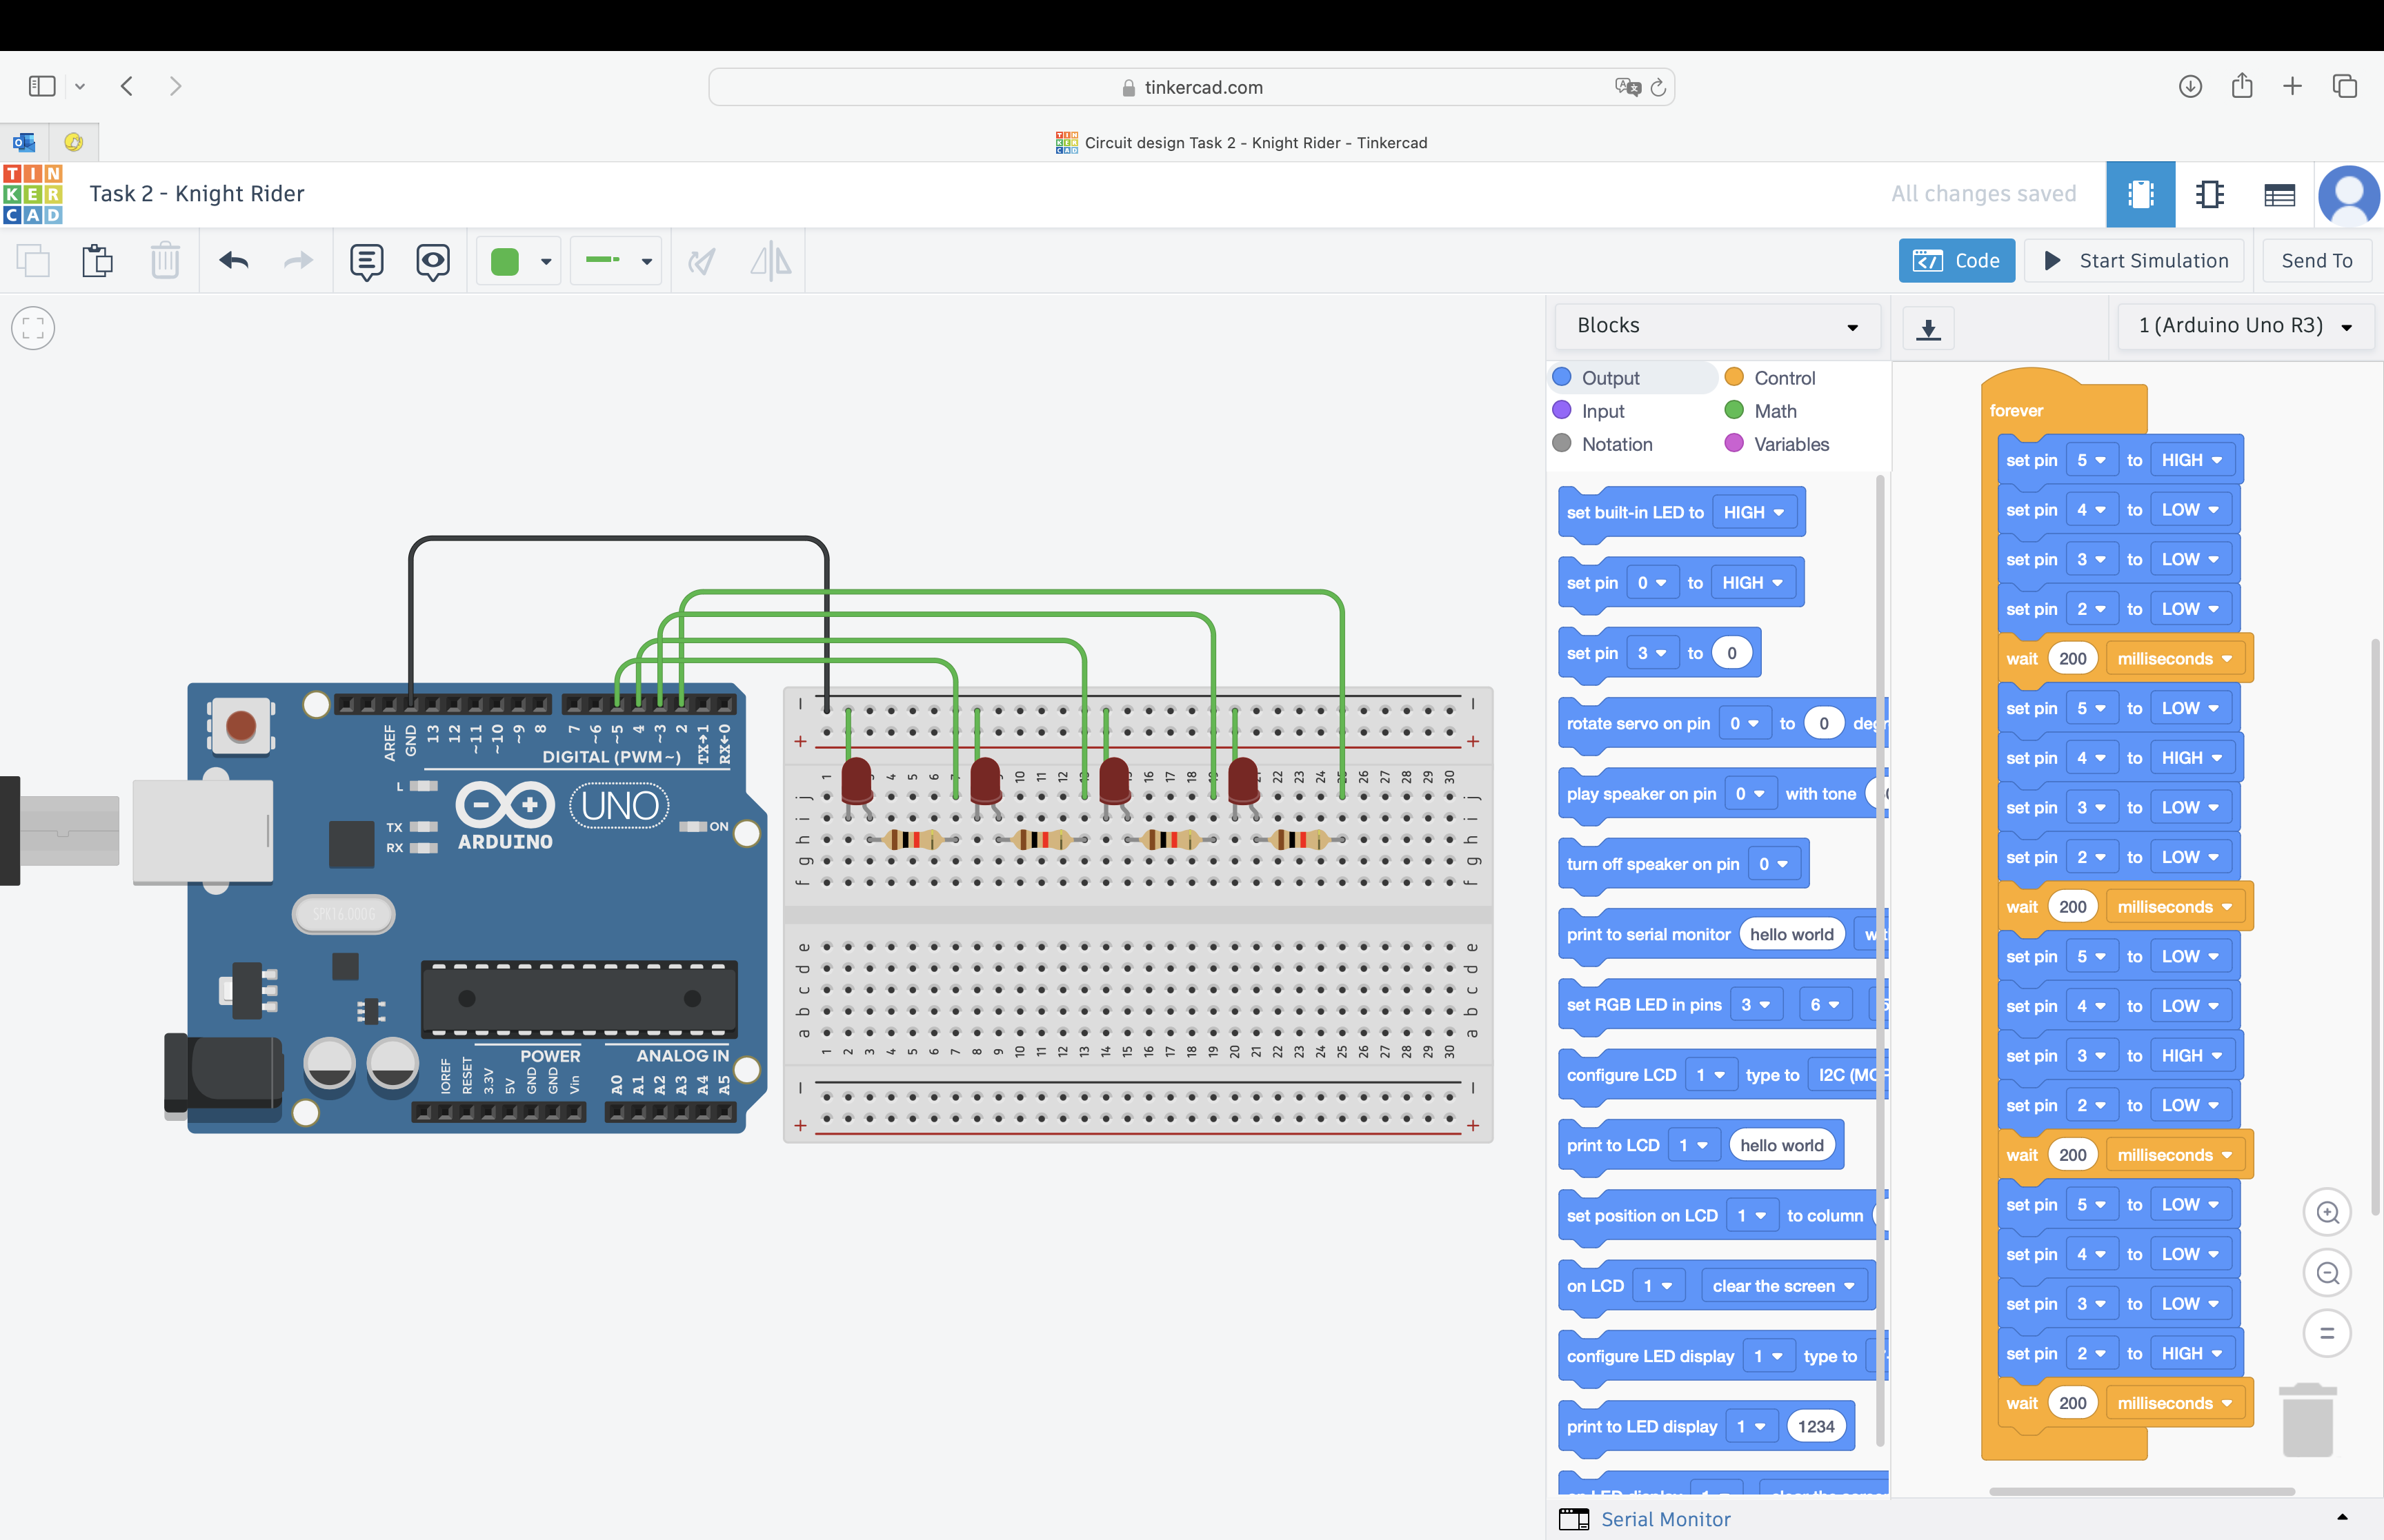

Slide 14
How can we bring this project
to life in the real world?

Slide 15
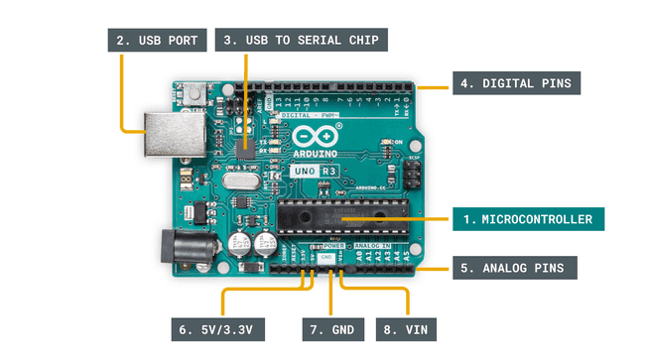

Introduction to Arduino: Hardware

Slide 16
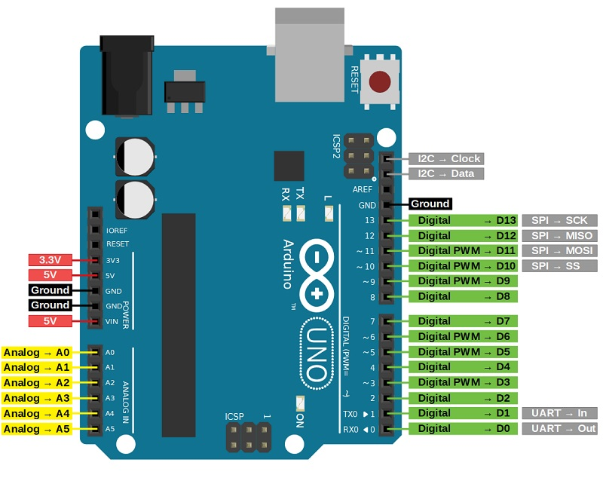
Arduino UNO
ESP 8266

Slide 17
ESP 8266

Slide 18
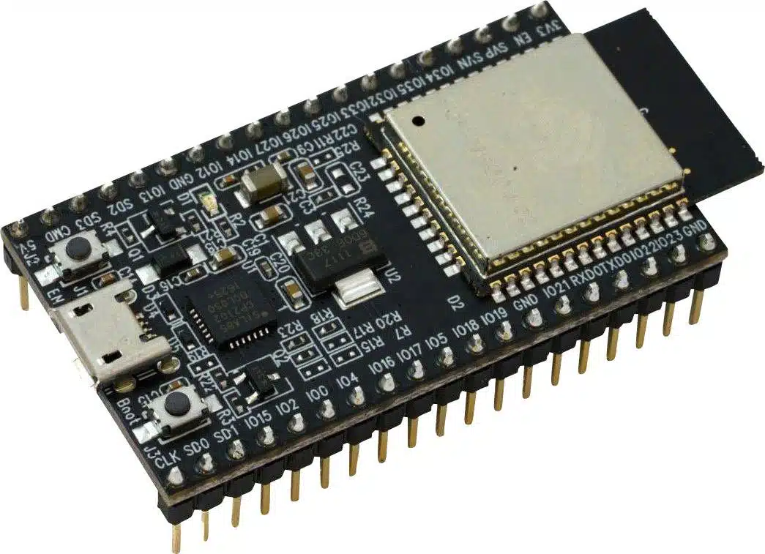
ESP8266
ESP8266 microcontroller integrated with Wi-Fi and Bluetooth module.
Very practical for IoT project
Low-cost
Low-power
Many GPIO pin

Slide 19
How can we bring this project
to life in the real world?

Slide 20

From Software Prototype (Tinkercad) To Hardware Protoype (ESP8266)
Test your design and idea in Tinkercad
Put your hardware components together (ESP, LEDs etc)
Use Arduino IDE to load the program into ESP8266

Slide 21
From Software Prototype (Tinkercad) To Hardware Protoype (ESP8266)
Test your design and idea in Tinkercad
Circuit connections (Arduino, breadboard, LEDs and wires)
Write program (block-based)
Simulate and test the program (working as expected)
Convert the program to C++
Put your hardware components together (ESP, LEDs etc)
Use Arduino IDE to load the program into ESP8266
Copy and paste the program to Arduino IDE
Upload the program to ESP8266
Verify and test your hardware (working as expected)

Slide 22
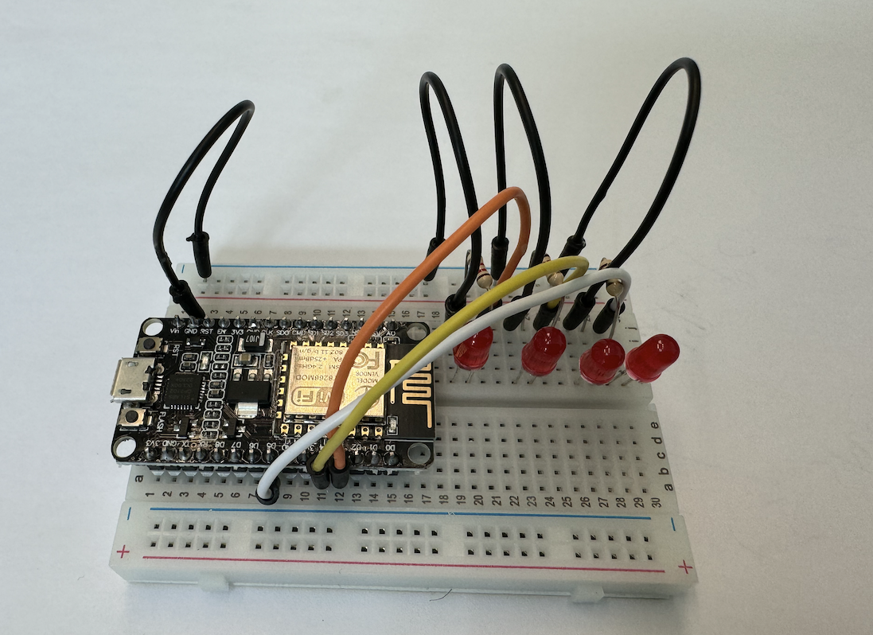
Assemble your hardware components (ESP, LEDs etc)

Slide 23
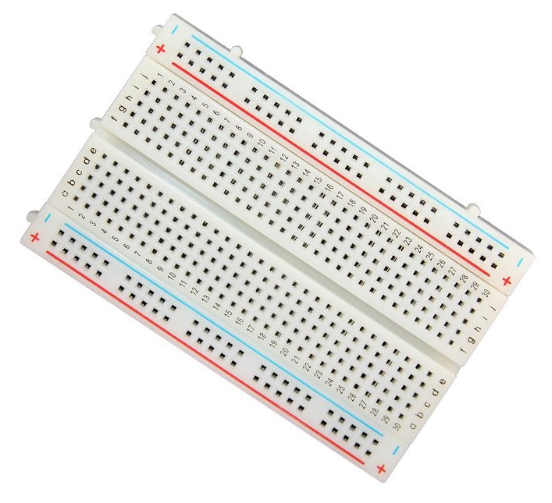
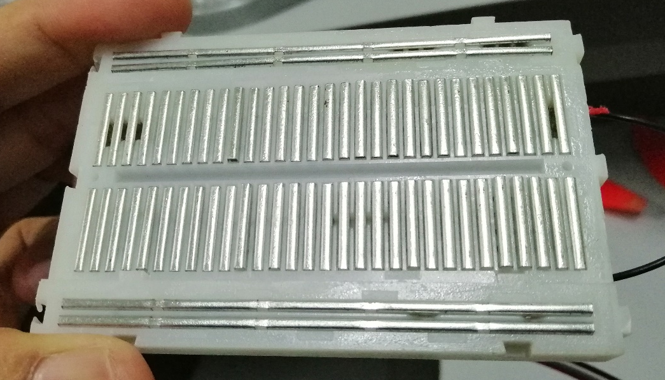
Notes: About Breadboard (internal connections)
Connected !

Slide 24
From Software Prototype (Tinkercad) To Hardware Protoype (ESP8266)
Test your design and idea in Tinkercad
Circuit connections (Arduino, breadboard, LEDs and wires)
Write program (block-based)
Simulate and test the program (working as expected)
Convert the program to C++
Put your hardware components together (ESP, LEDs etc)
Use Arduino IDE to load the program into ESP8266
Copy and paste the program to Arduino IDE
Upload the program to ESP8266
Verify and test your hardware (working as expected)

Slide 25
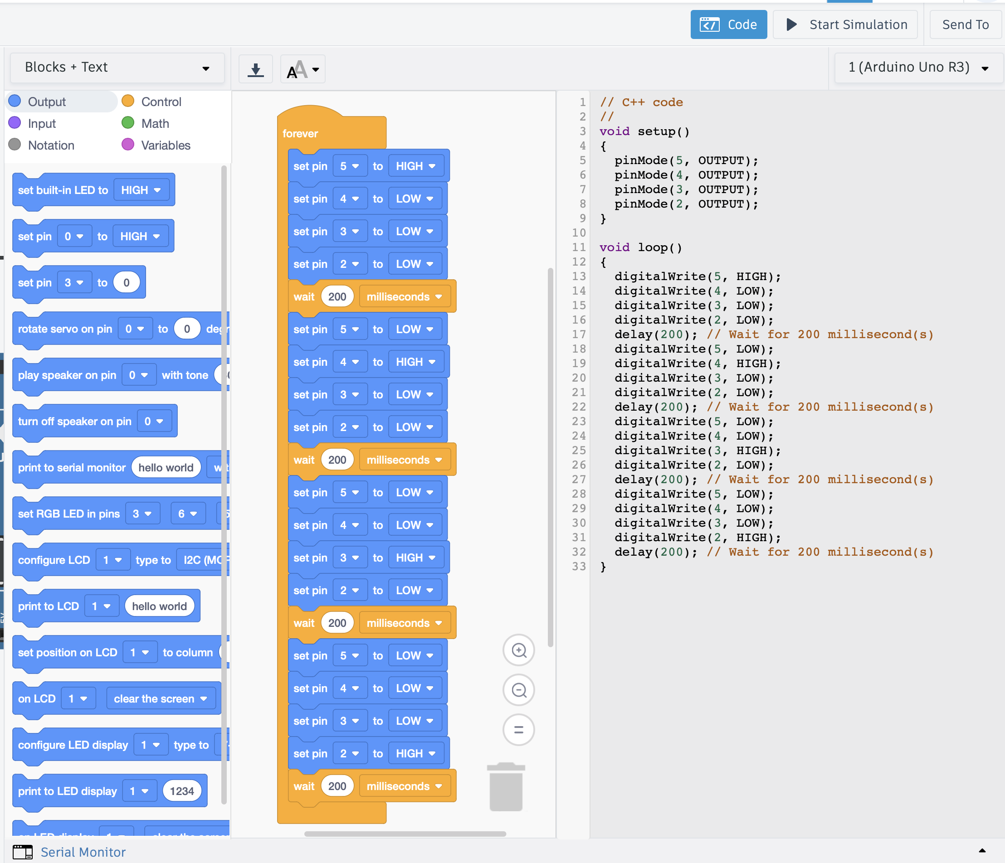
Copy C++ Code from Tinkercad,

Slide 26
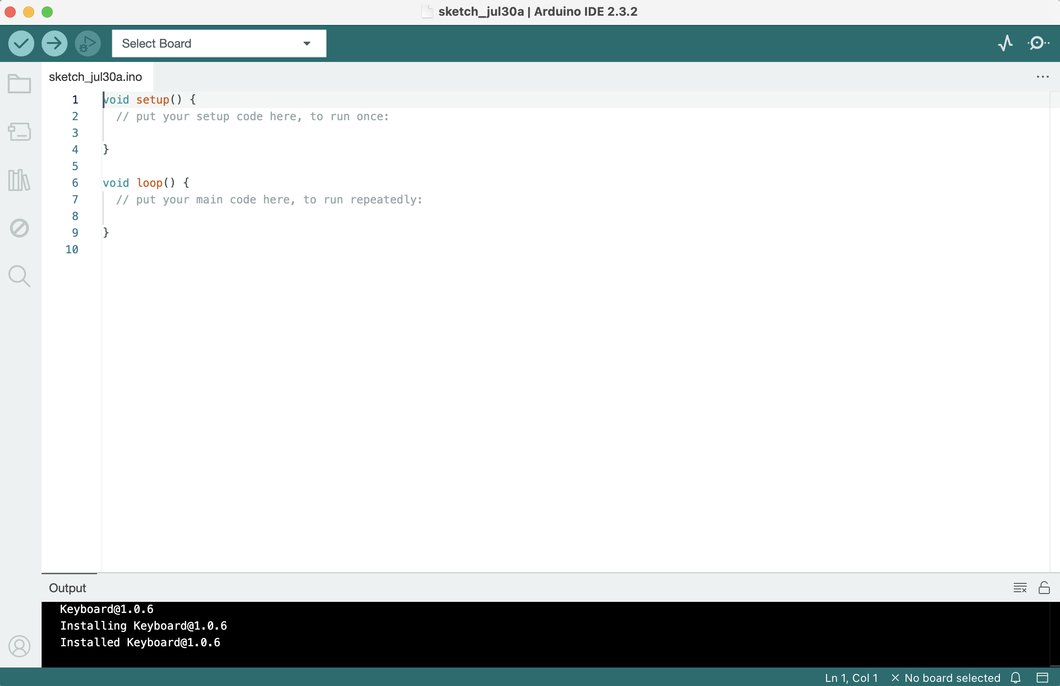
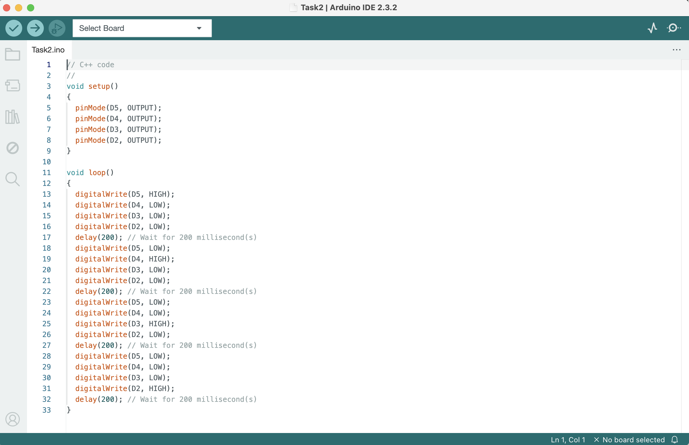
Copy C++ Code from Tinkercad, and then Paste C++ Code in Arduino IDE

Slide 27
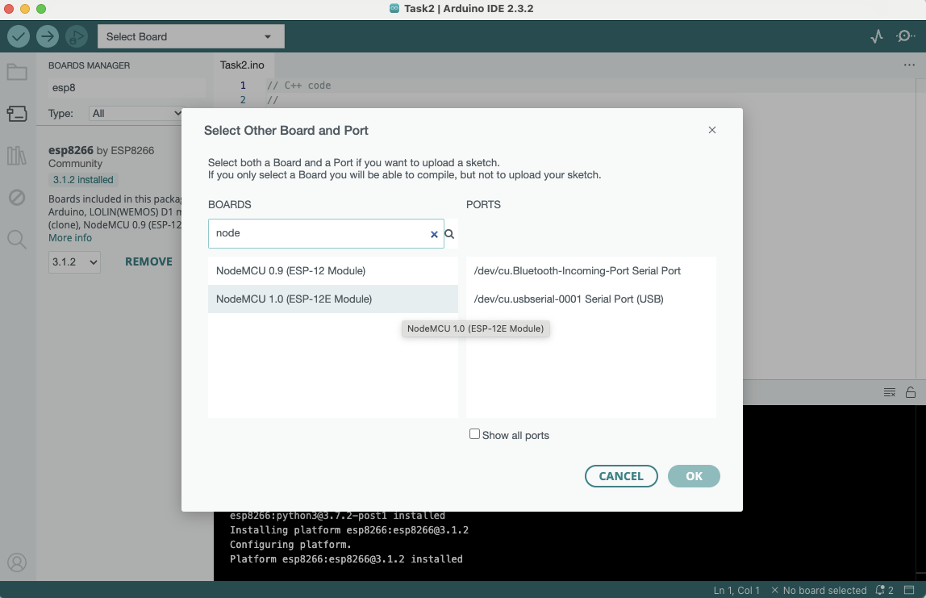
Select Board

Slide 28
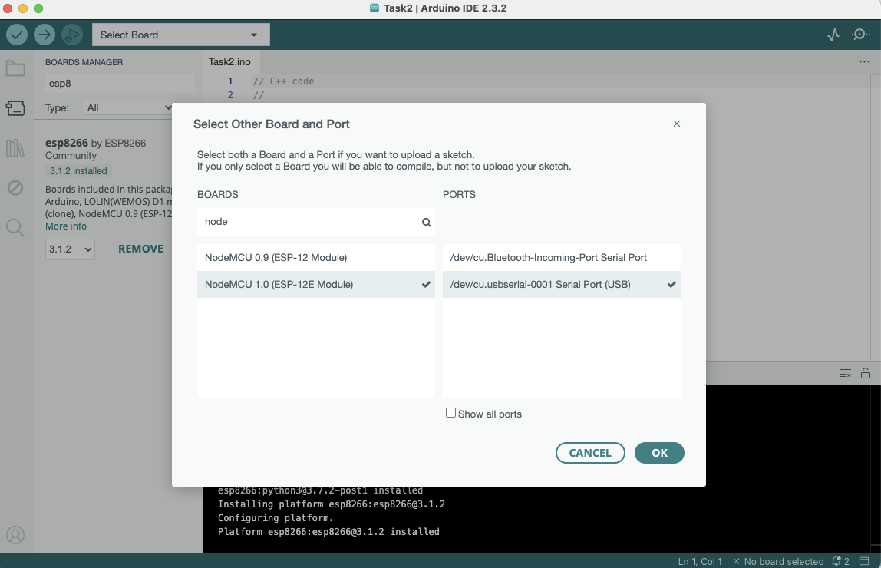
Select Board and Port (it is okay if different port)

Slide 29
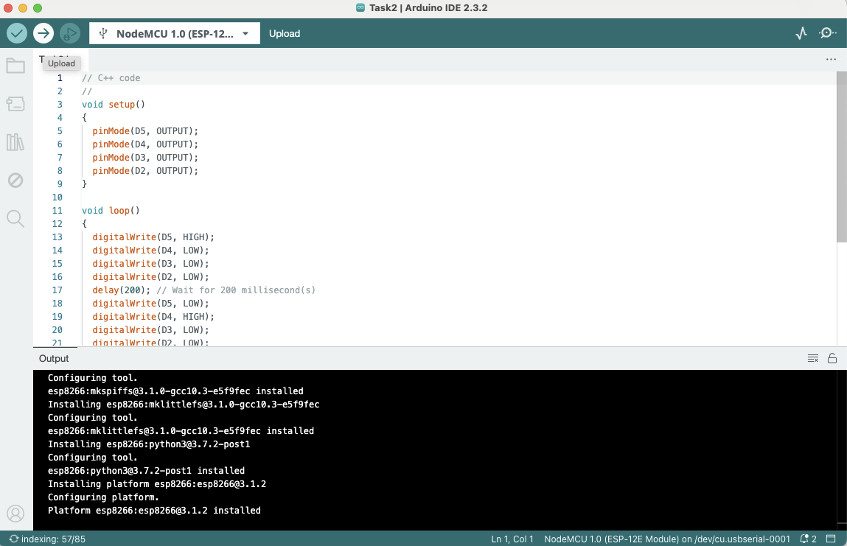
Click ”Upload”

Slide 30
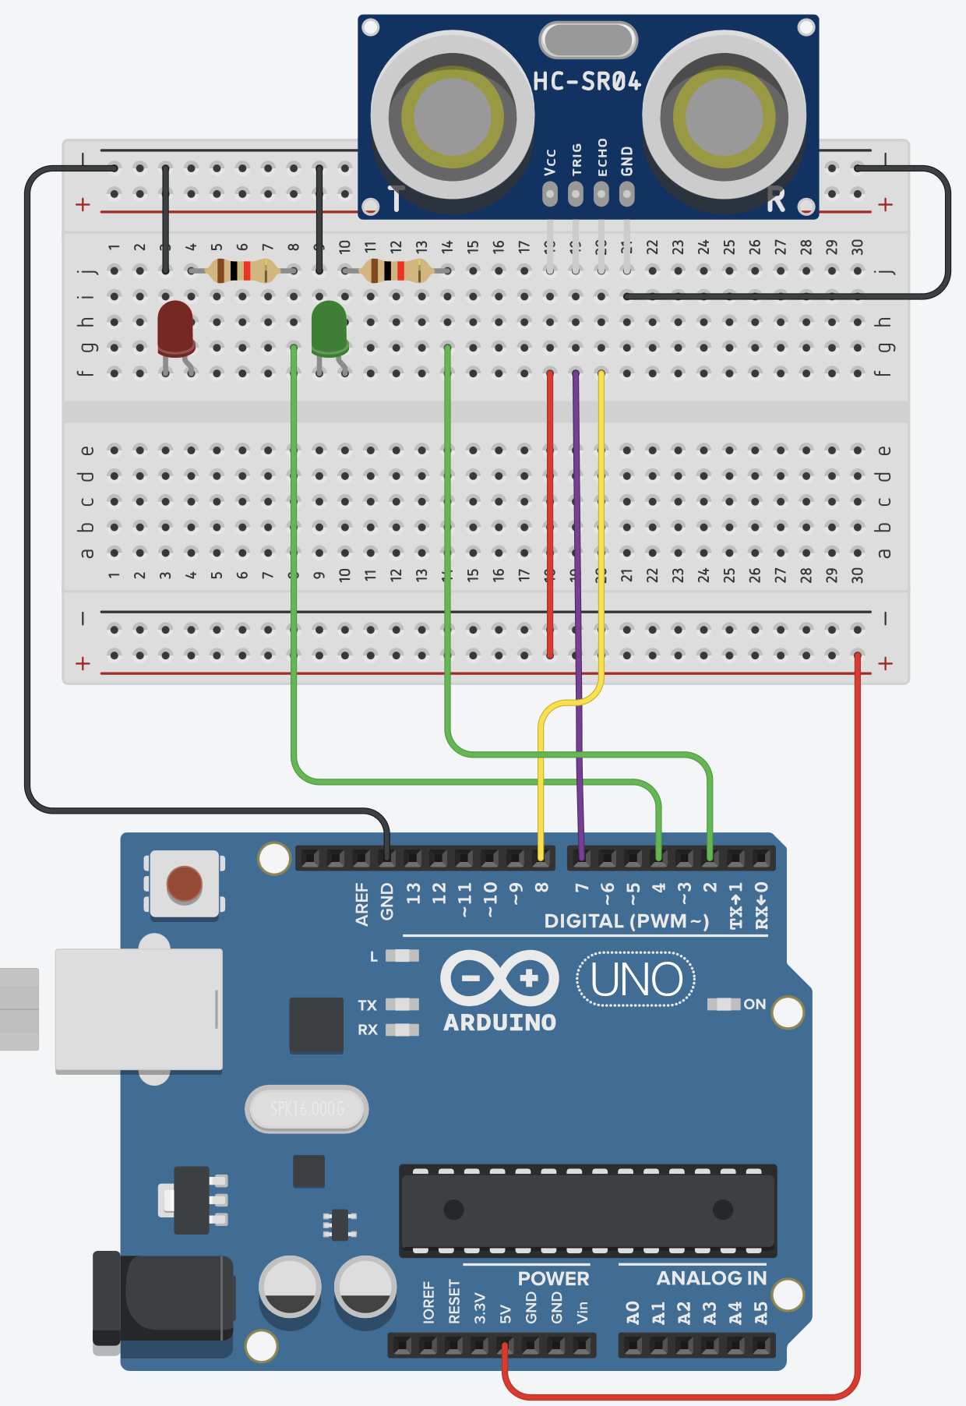
Task 3: Ultrasonic Sensor Reading
Mission: Read the distance reading from ultrasonic sensor, and to the following:
Turn ON GEEEN LED if the distance less than 100 inc,
Turn ON RED LED if the distance is more than 100 icn
Description:
The ultrasonic sensor reading will change according to the distance of object in front.
Steps:
Connect the ultrasonic sensor to the Arduino.
Vcc to 5V
Trig to pin D7
Echo to pin D8
GND to GND
Connect RED LED to pin D4
Connect RED GREEN to pin D2
Write down the algorithm to perform this operation.

Slide 31
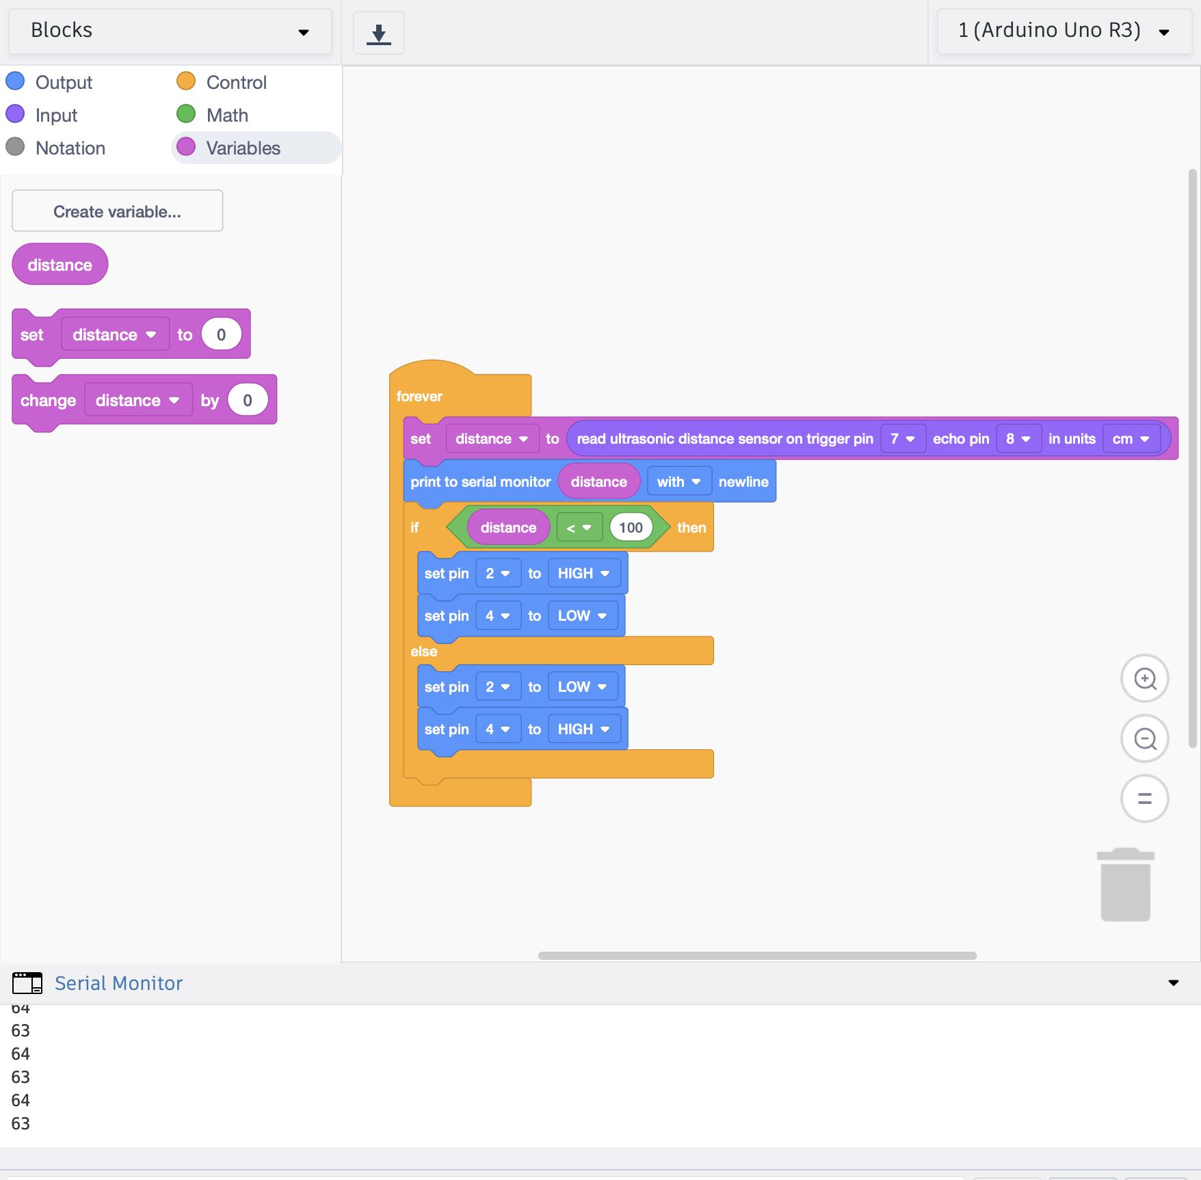

Slide 32
Task 3: Ultrasonic Sensor Reading

Slide 33
How can we bring this project
to life in the real world?

Slide 34
Now, build your
(ultrasonic) hardware prototype

Slide 35
IoT and 5G
(using Node-RED)

Slide 36


Slide 37
Concept of IoT
Sensors
(Temperature, Humidity and Light intensity)

Slide 38
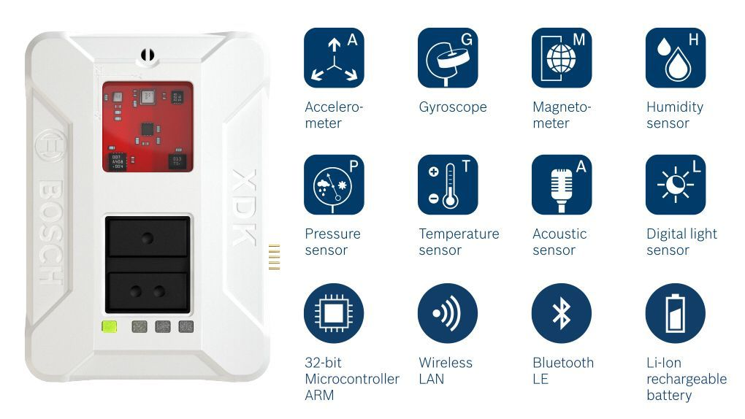
XDK 110

Slide 39
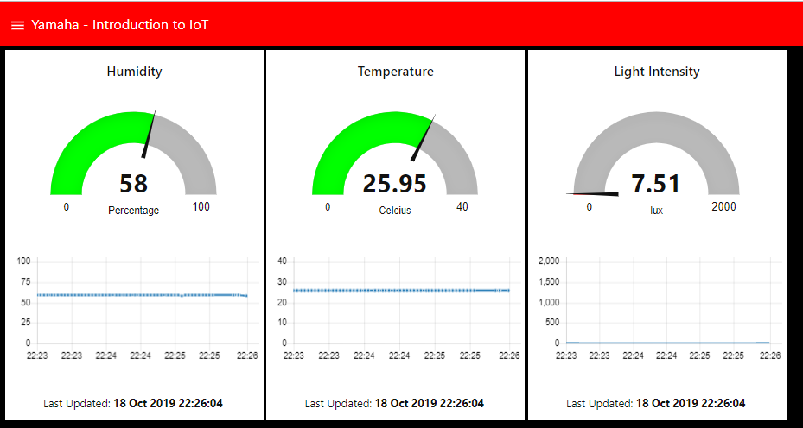
Dashboard

Slide 40


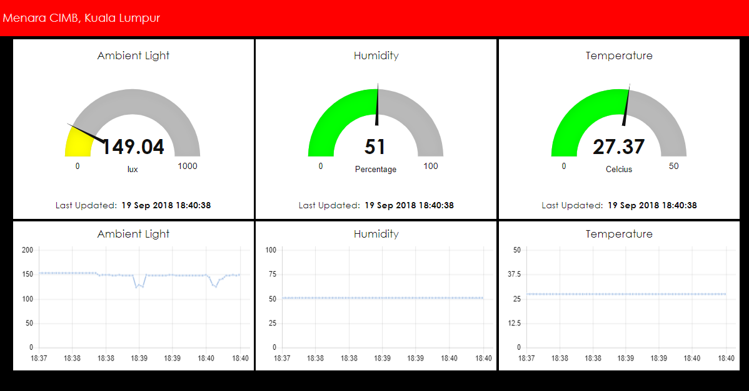
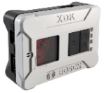
Sensor, Network and Dashboard
Internet
Network: provides connectivity
2
IOT Platform (Dashboard):
user interface for visualization
Thing: measures and sends data
3
1

Slide 41
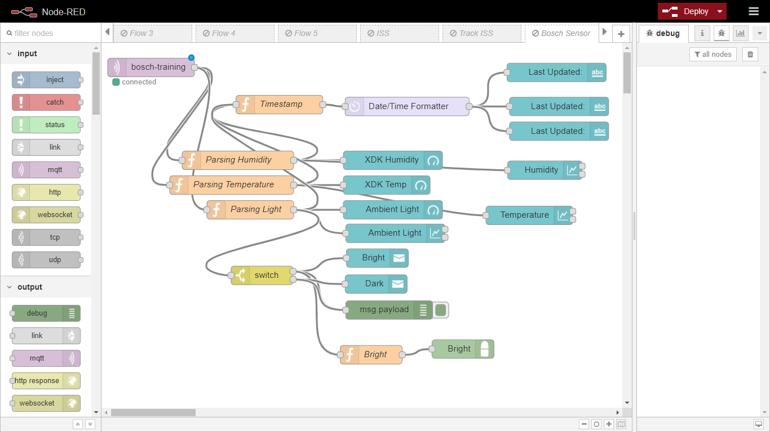

Slide 43
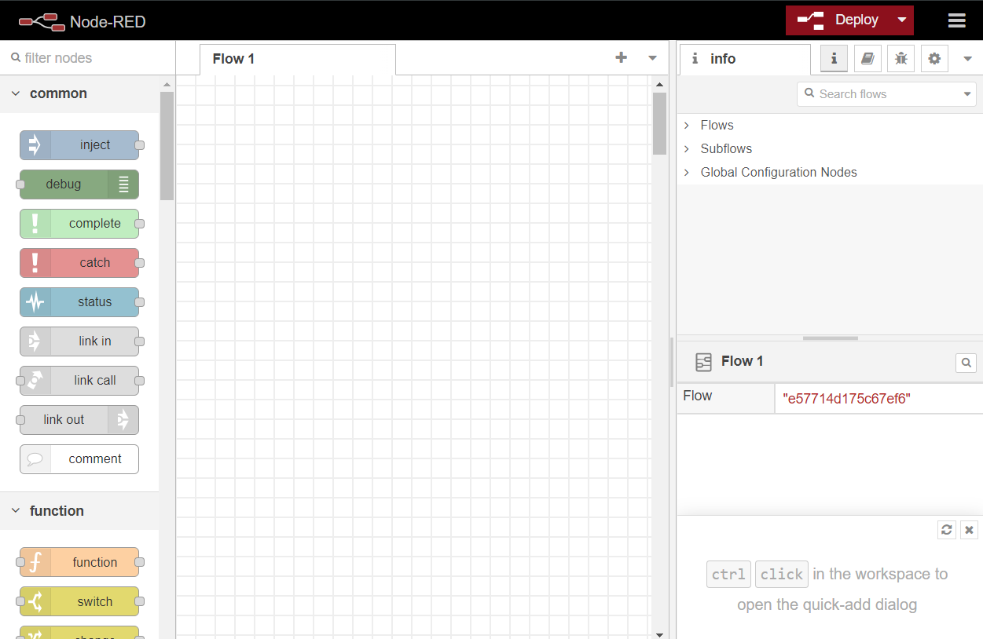

IoT – Node-RED
Node-RED is a programming tool for wiring together hardware devices, APIs and online services in new and interesting ways.
It provides a browser-based editor that makes it easy to wire together flows using the wide range of nodes in the palette that can be deployed to its runtime in a single-click.

Slide 44
IoT – Node-RED
Deploy
Debug
Nodes
Canvas

Slide 45
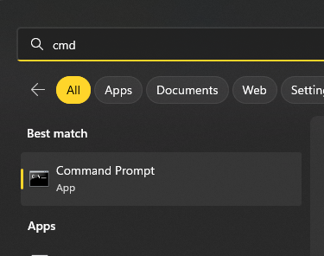
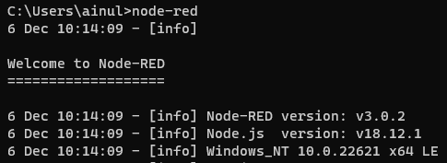

IoT – Node-RED
Press Win key and type “cmd”
Open Command Prompt
Type “node-red”
Press Enter

Slide 46
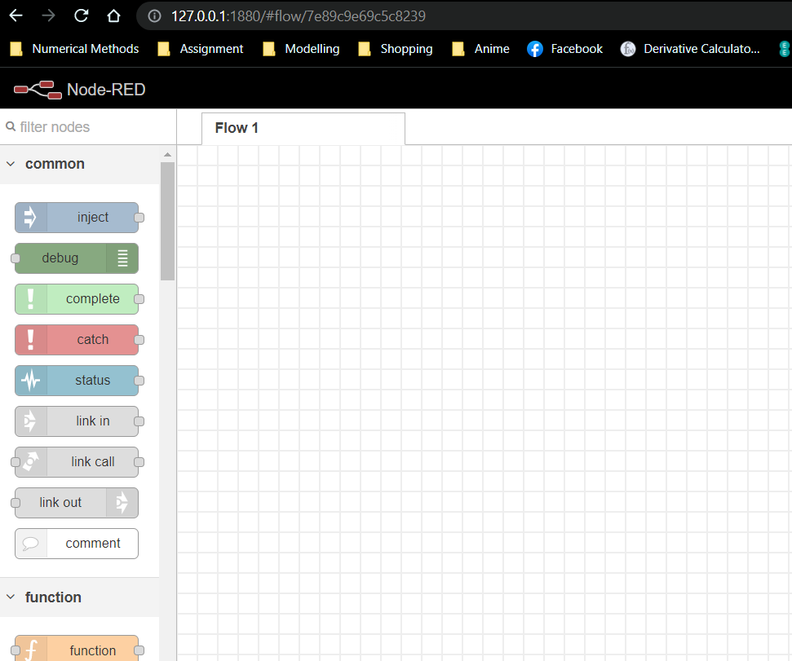
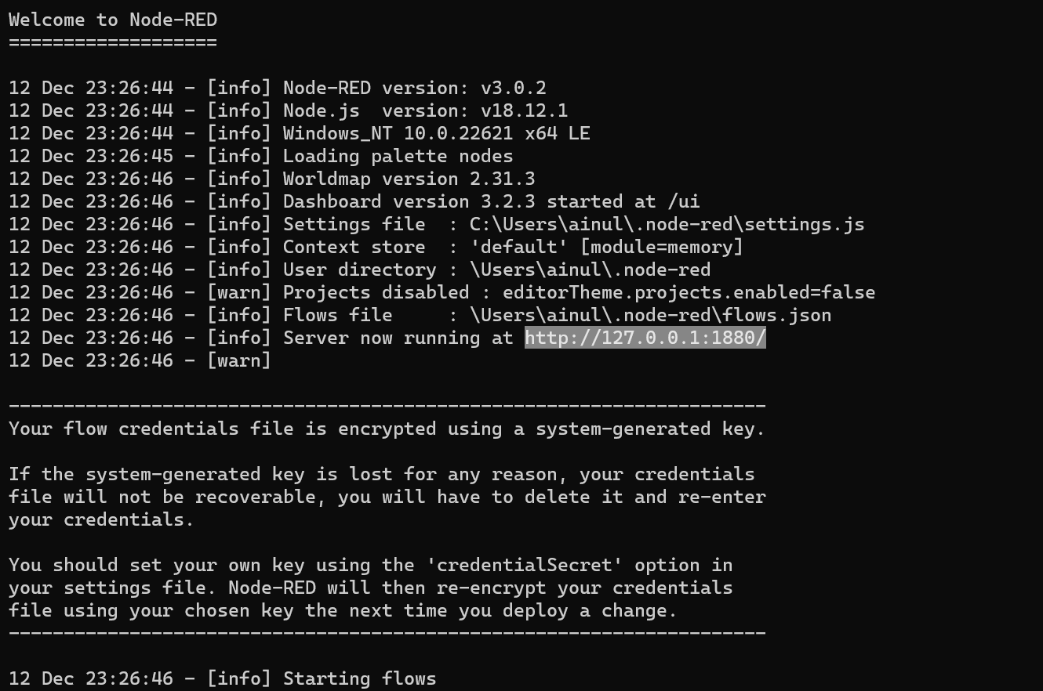
IoT – Node-RED
Copy the URL
Open browser and paste the URL
Press Enter

Slide 47
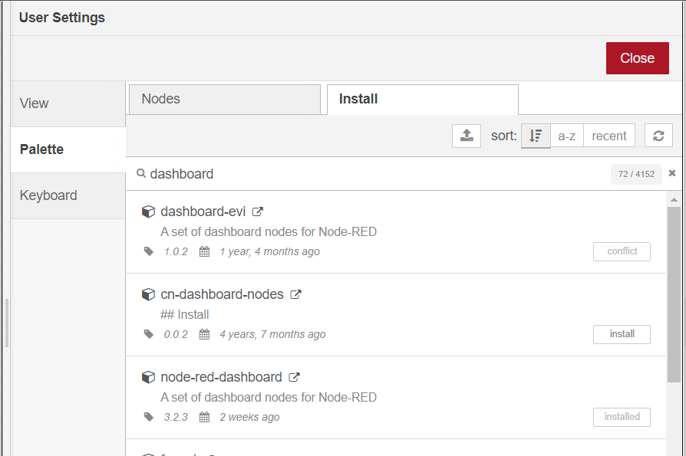
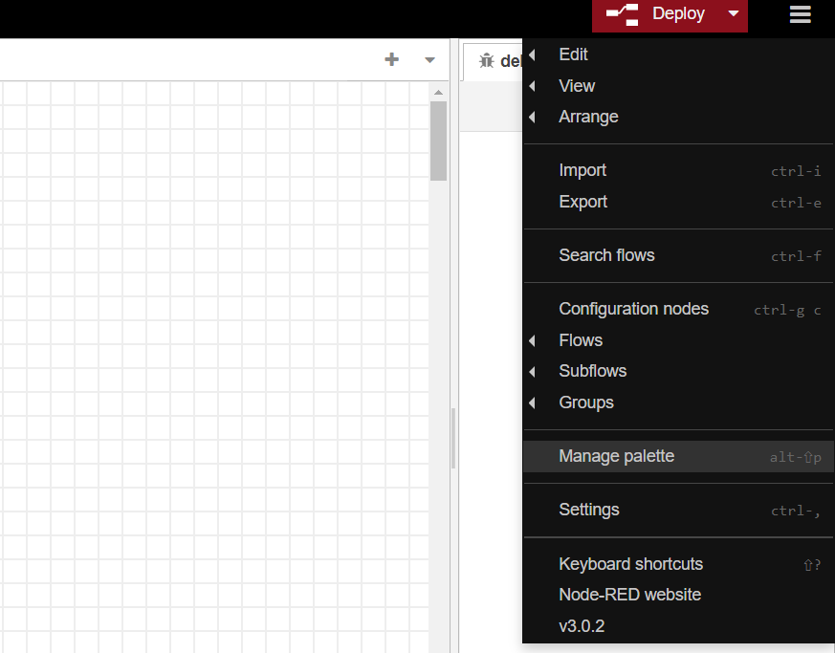
IoT – Node-RED
Press the triple line
Click manage palette
Click install
Type dashboard and install

Slide 48
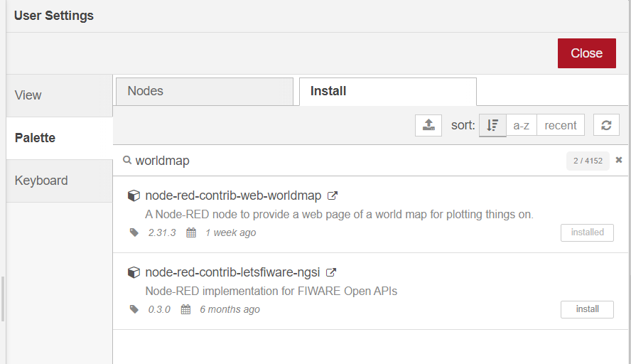
IoT – Node-RED
Type worldmap
Install
Click Close

Slide 49
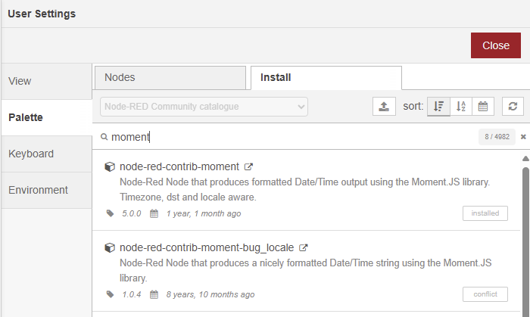
IoT – Node-RED
Type moment
Install
Click Close

Slide 50
Task #1
Hello World!

Slide 51


Slide 52
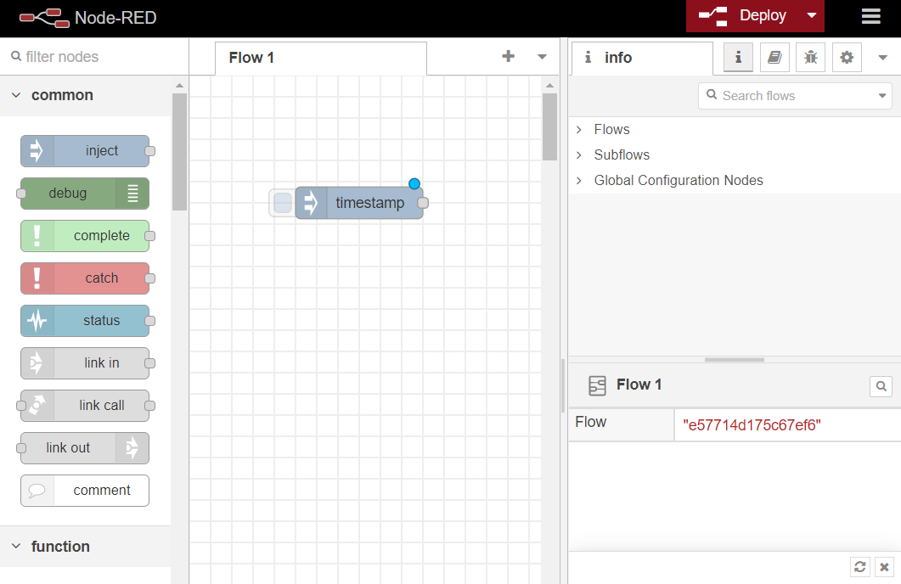
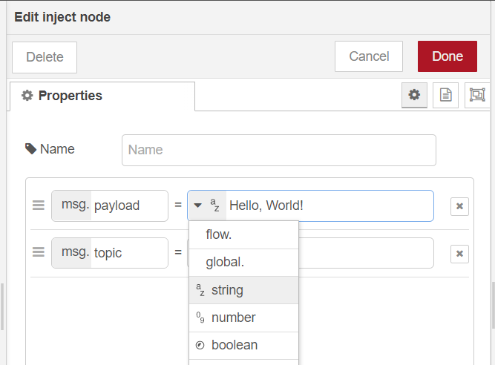
IoT – Node-RED
First Activity
Drag and place the inject node inside canvas
Double click the inject node
In payload field, select string and enter “Hello, “World!

Slide 53
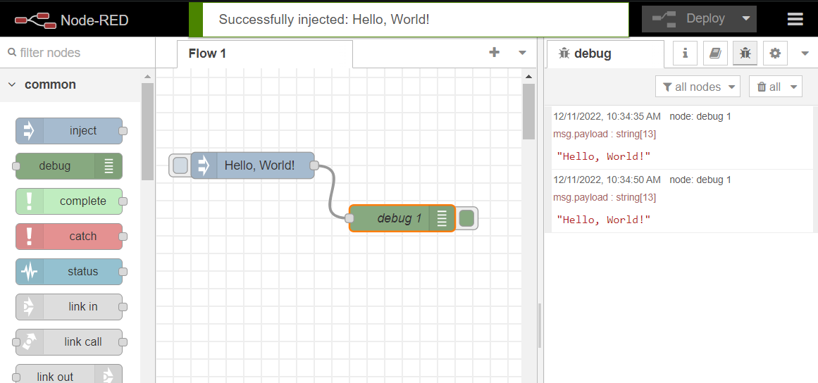
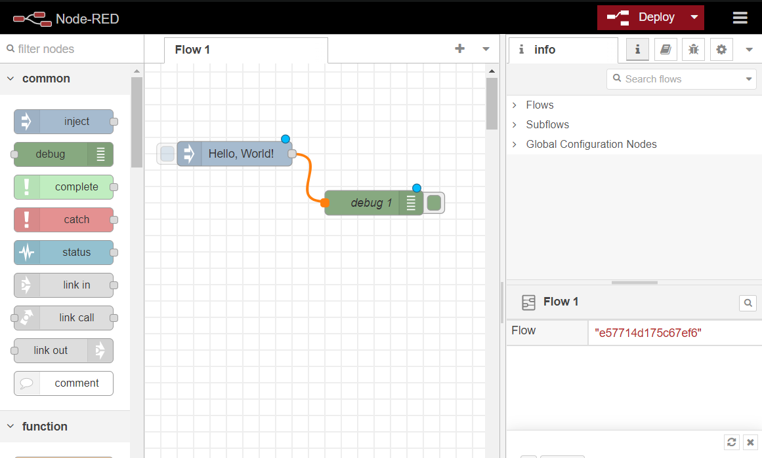
IoT – Node-RED
Drag and place the debug node inside canvas
Connect the nodes together
In payload field, select string and enter “Hello, “World!
Deploy and Run

Slide 54
Task #2
Send Message
(from your computer to my computer)

Slide 55
MQTT

Slide 56

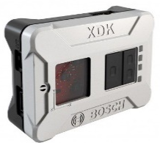
Send Data through MQTT
MQTT Subscriber
MQTT Publisher
Send ‘Sensor Data’ through MQTT

Slide 57
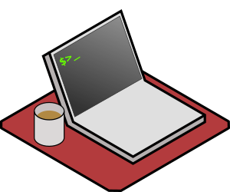

Exercise
Your Laptop
Sensor at My House
Send ‘Data’
Send ‘Data’ through MQTT
MQTT Publisher
MQTT Subscriber

Slide 58
Send & Receive Data using MQTT
MQTT Broker
Example:
Topic = “xdk10”
Topic
(& Data)
Topic
(& Data)
MQTT Subscriber
MQTT Publisher
Send ‘Sensor Data’ through MQTT

Slide 59
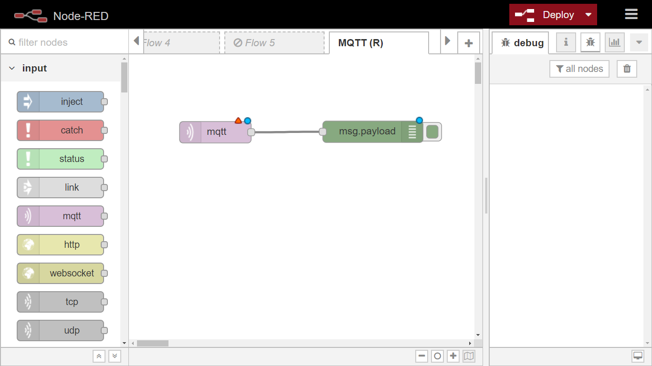

Slide 60
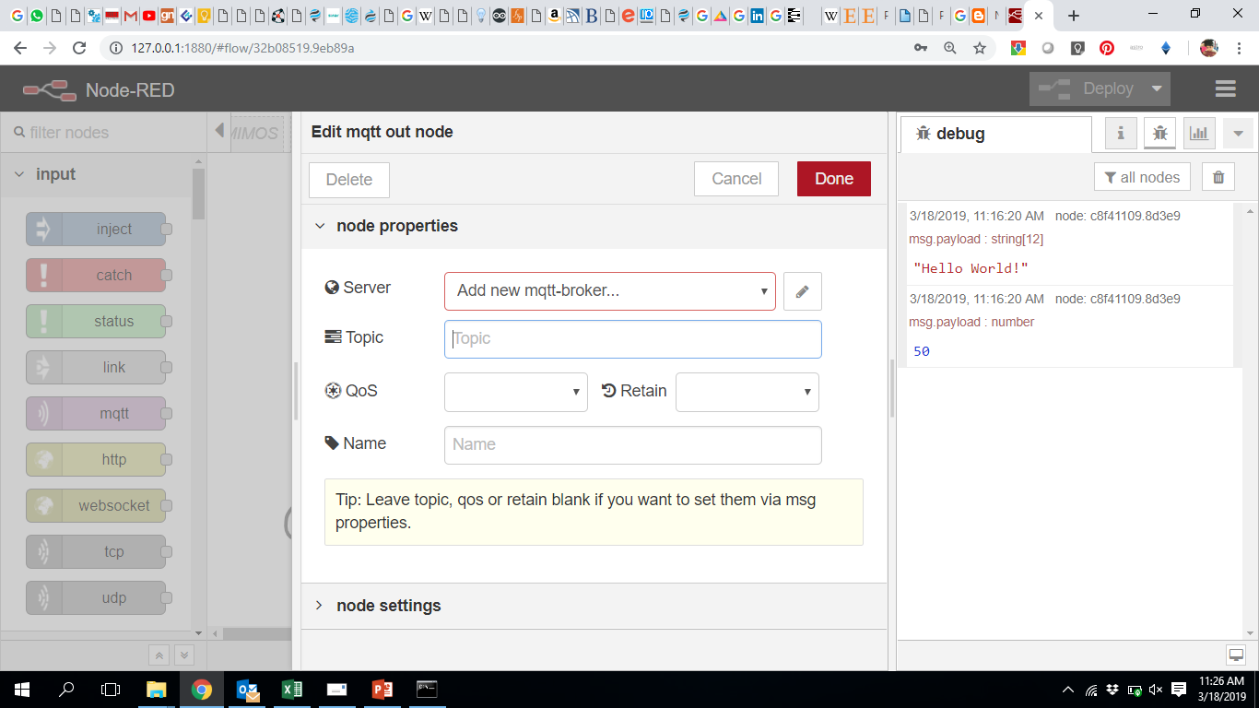
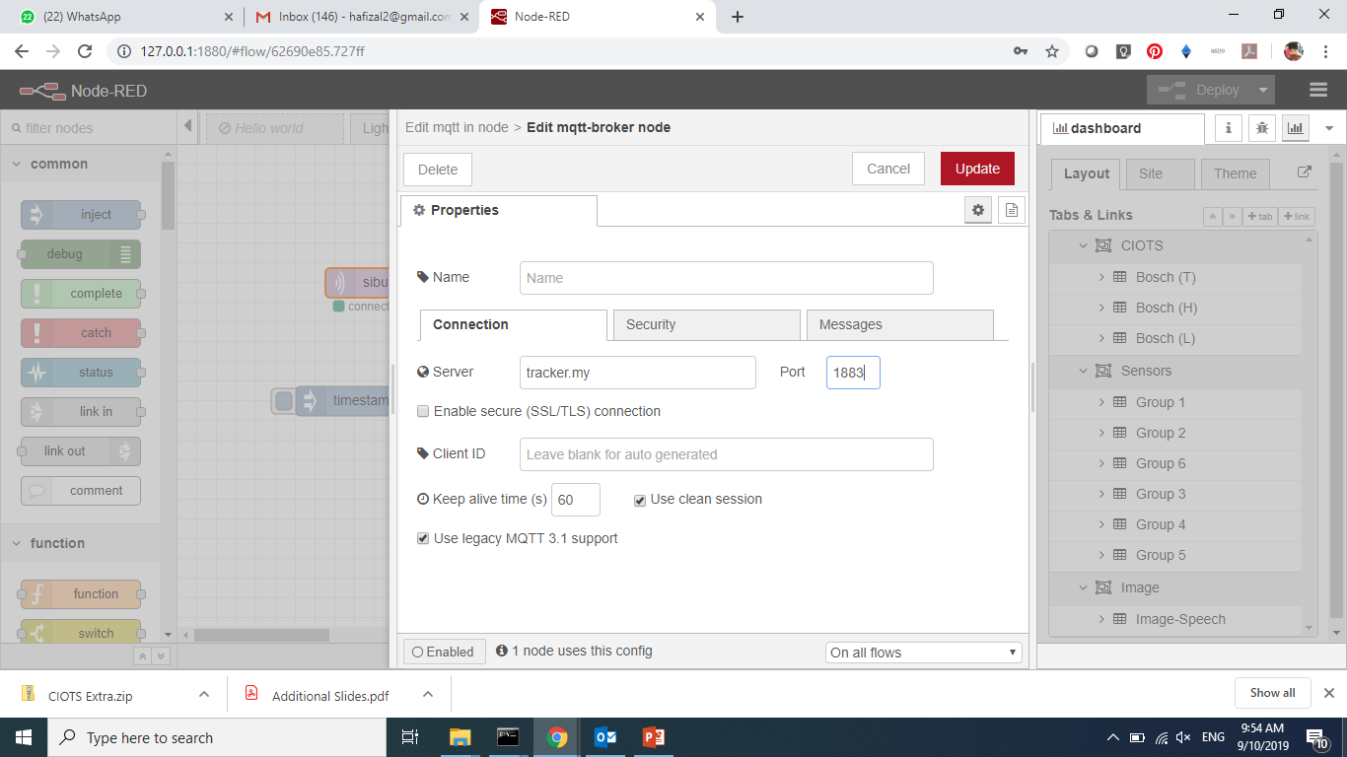
Configure MQTT Broker
Server: 174.138.28.115
Port: 1883
Click here
174.138.28.115

Slide 61
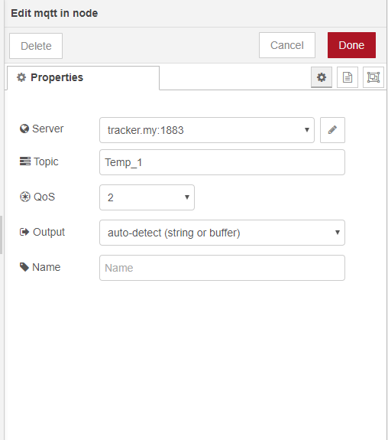
174.138.28.115:1883

Slide 62
Task #3 (DIY)
Get data from ESP8266

Slide 63
Step 1: Use Arduino IDE and upload new code to your (ultrasonic) hardware prototype

Slide 64
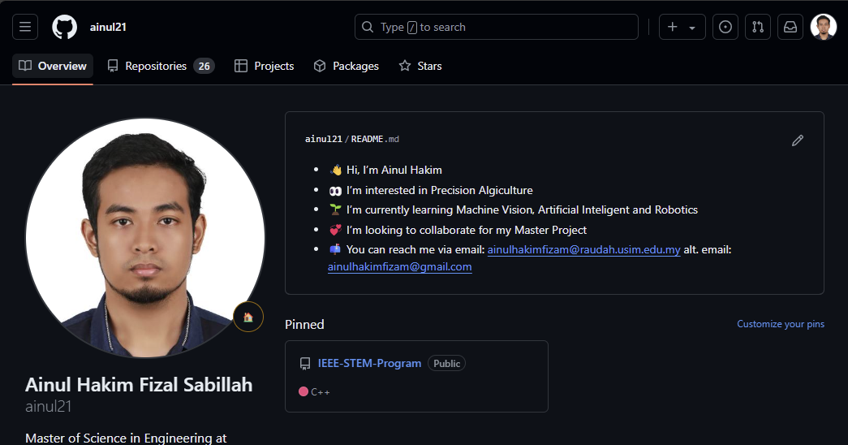
GitHub
Open browser
Type URL
github.com/ainul21

Slide 65
GitHub
Open IEEE-STEM-Program

Slide 66
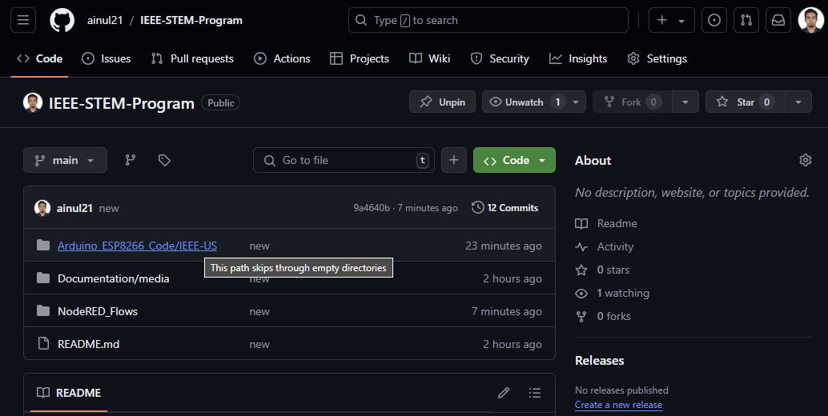
GitHub
Open Arduino_ESP8266_Code

Slide 67
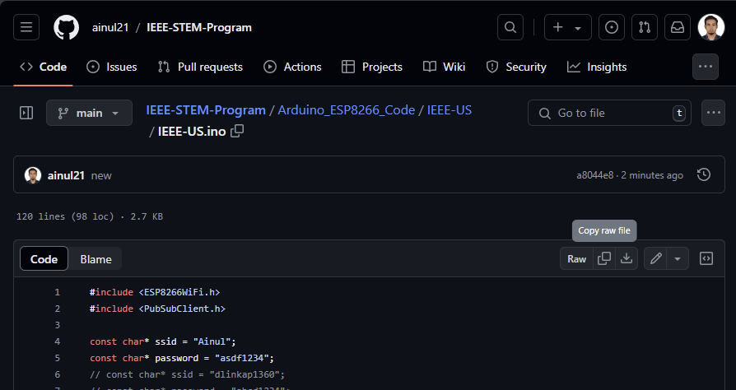
Arduino IDE
Task #3
Go to IEEE-US.ino
Open file name: IEEE-US.ino
Copy the code

Slide 68

Arduino IDE
Paste the code
Click Upload

Slide 69
Step 2: Import Node-RED flow (from GitHub)

Slide 70

IoT – Node-RED
Task #3
Go to NodeRED_Flows

Slide 71

Node-RED
Task #3
Open file name: Ultrasonic_Node-red.json
Copy the code

Slide 72

Node-RED
Click triple line button
Click Import

Slide 73

Node-RED
Paste the code
Click Import

Slide 74
Step 3: Display data from ESP8266 in Node-RED

Slide 75


Slide 76


Slide 77

Step 3: Display data (from ESP8266) in Node-RED

Slide 78


Slide 79
Final Mission…

Slide 80

Can you switch on the light bulb from your computer?

Slide 81
Let’s try another mission…

Slide 82


Slide 83
Where is the International Space Station (ISS)?
Exercise: Tracking ISS using Node RED
Latitude and Longitude
Source Wikipedia: The International Space Station (ISS) is a space station, or a habitable artificial satellite, in low Earth orbit. Its first component launched into orbit in 1998, the last pressurised module was fitted in 2011, and the station is expected to operate until 2028. Development and assembly of the station continues, with components scheduled for launch in 2018 and 2019. The ISS is the largest human-made body in low Earth orbit and can often be seen with the naked eye from Earth.^{[8][9]} The ISS consists of pressurised modules, external trusses, solar arrays, and other components. ISS components have been launched by Russian Proton and Soyuz rockets, and American Space Shuttles.^{[10]}

Slide 84

http://api.open-notify.org/iss-now.json

Slide 85

Display on Map?

Slide 86
IoT – Node-RED
Open browser
Type URL
github.com/ainul21

Slide 87
IoT – Node-RED
Open IEEE-STEM-Program

Slide 88
IoT – Node-RED
Task #2
Go to NodeRED_Flows

Slide 89

IoT – Node-RED
Task #2
Go to TrackISS.json
Open file name: TrackISS.json
Copy the code

Slide 90
IoT – Node-RED
Click triple line button
Click Import

Slide 91

IoT – Node-RED
Paste the code
Click Import

Slide 92


IoT – Node-RED
Click Import copy
Import complete

Slide 93

IoT – Node-RED
Click Deploy
Run the flow by clicking the inject trigger

Slide 94


IoT – Node-RED
To open the map, copy the URL as below
Open new tab and paste the URL
Add worldmap at the end of /
Press Enter

Slide 95

IoT – Node-RED
Zoom and drag to achieve the best result of the tracker

Slide 96

INTRODUCTION TO EMBEDDED SYSTEM
Embedded System

Slide 97


Similarity?
Embedded system: microprocessor- or microcontroller-based system of hardware and software designed to perform dedicated functions within a larger mechanical or electrical system.

Slide 98
Embedded System vs. General Purpose
General Purpose Computer | Embedded system
Intended to run a fully general set of applications | Runs a single or limited applications often known at design time
Resources are plenty, Faster is always better | Resources are scarce, operates in fixed run-time constraints, additional performance may not be useful/valuable
Differentiating features: Speed (need not be fully predictable) Cost (eg RM3k vs RM5k per laptop) Software compatibility | Differentiating features: Speed (must be predictable) Power Cost (eg RM2 vs RM2.50) Size Software compatibility problems

Slide 99


Example of embedded products using microcontroller:

Slide 100
MICROCONTROLLER, SENSOR & ACTUATOR

Slide 101




What is microcontrollers ?
A microcontroller is a single chip devices or single chip computers in a small size that it resources are far more limited than those of a desktop personal computer.
It is designed for standalone operation
It is includes:
Process unit
RAM & ROM
I/O
Buses
Etc.
e.g., Microcontroller is the robot brain. It allows the designer to interface sensors and specialized control electronics together (along with anything else required for the project) and contain the overall logic of the robot.
Microcontroller is the brain of devices and it operates on its own to control the designed system
Notes:
Keyword is standalone

Slide 102


Microprocessor vs. Microcontrollers
Microprocessor | Microcontroller
It contains fundamental unit of computing –ALU, registers, etc | ROM, RAM, Digital and analog I/O, and peripherals such as communication interfaces are available
Used for tasks that are complex and tricky like development of software’s, games, image processing and other applications with high memory requirement | Single chip and does not require external circuit. Used mostly in embedded system, fast control loop operation.
Fast processing speed | Relatively slower processing speed as compared to microprocessor

Slide 103

Microprocessor vs. Microcontroller

Slide 104









Microcontroller Manufacturers

Slide 105
List down 5 devices around you that contain microcontrollers?

Slide 106

How to get started?
Simplest development tools
Online community for support and sharing
Cost-effective

Slide 107

Sensor and Actuator – Interfaced to microcontroller
Physical signals such as temperature, humidity, light, speed, etc. are analog signals (continuous)
Sensors are used to convert the physical signals into digital form that can be used by microcontroller (Input)
Microcontroller will perform the operation according to the program written by users
Appropriate output signal from microcontroller is used to drive actuators of the system (output)
Notes:
Analogy with human sense: touch, smell, taste, hearing, sight. Send signal to brain to perceive (tafsir)

Slide 108

Sensor and Actuator – Interfaced to microcontroller
Solar tracking system
Solar panel will be rotated in such a way that the panel will get ‘maximum’ concentrated sunlight for optimum power generation.
- Sensor : light detector
Microcontroller : based on the intensity of light, it will calculate the optimum angle for the panel to receive the sunlight
Actuator : DC or Stepper motor will be rotated according to the calculated angle

Slide 109


Check the components given..

Slide 110
INTRODUCTION TO ARDUINO

Slide 111

Introduction to Arduino
Arduino is a company/community that designs and manufacture open-source single-board microcontrollers for building digital devices.
Notes:
What is Arduino

Slide 112



Family of Arduino

Slide 113

Introduction to Arduino: Hardware

